Slide 1

Proposal On NepHench
By Astha Shrestha
Diwash Karki
Simran Shilpakar
This Photo by Unknown author is licensed under CC BY-SA.

Slide 2
Introduction
NepHench Android App is a mobile application designed to help users find and book reliable and professional plumbing and electrical services in their area.
NepHench schedule GPS tracking system that helps users locate nearby service providers.
Reach a wider audience without the need for expensive advertising campaigns which streamlines the booking process and effort required for both service provider and users.

Slide 3
Problem Statement
Existing service apps lack the feature of location tracking of the service provider.
Some apps doesn't provide transparent pricing or information about the service providers.
Users face difficulties in getting in touch with customer support or resolving issues related to appointments, payments, or service quality.

Slide 4
Objective
To provide reliable and convenient platform services in Nepal.
To connect users with verified and trustworthy service providers in their local area.
To offer a user-friendly interface that allows users to easily select the type of service they need, view service provider profiles and ratings, and book appointments.

Slide 5
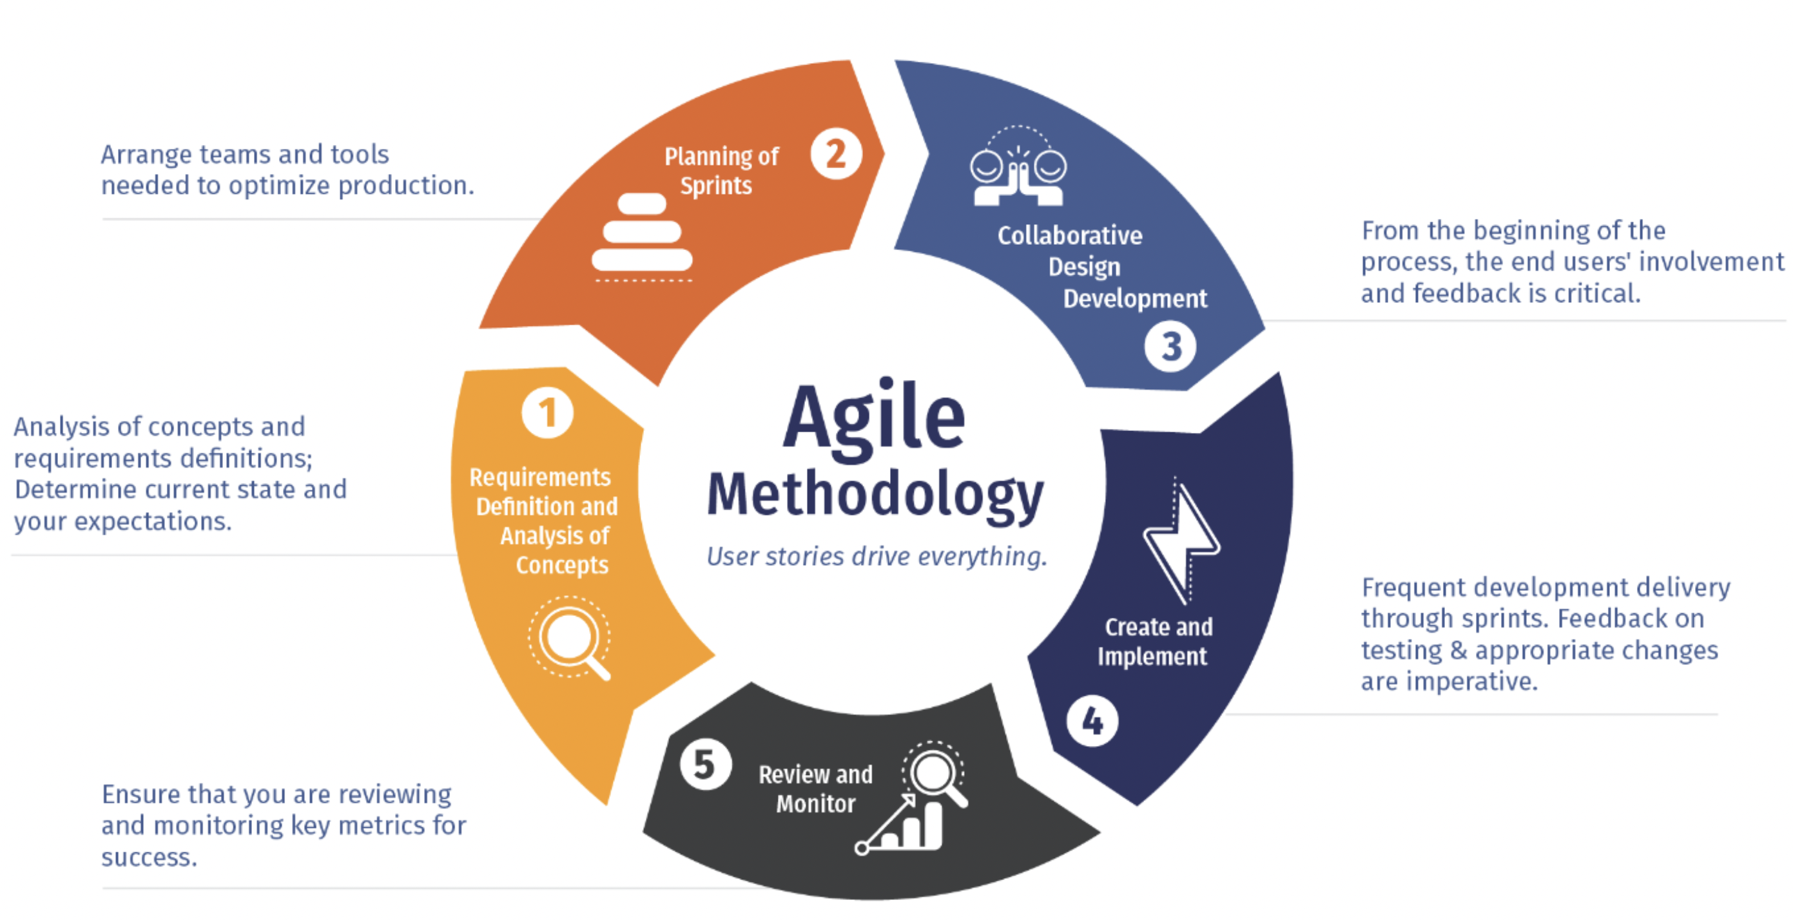

Slide 6
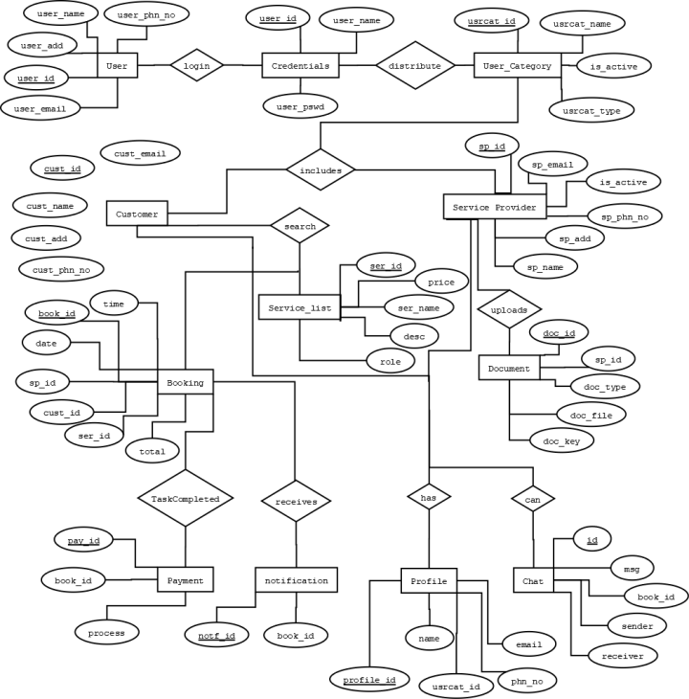

Slide 7
Deliverable
User acquisition
Appointment scheduling
Payment integration
Review and rating system
In-app messaging
Geolocation
Notification

Slide 8
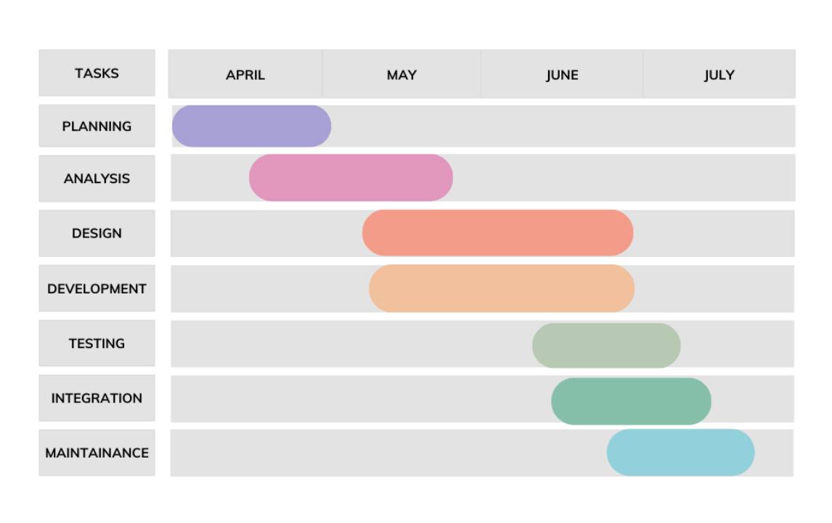
Project Gantt Chart

Slide 9


